Slide 1

Predicting Diabetes AI Bootcamp Project 2 March 4, 2024

Slide 2
Agenda
Executive Summary
Project Goals
Project Resources
Data Exploration
Workflow
Model Optimization
Project Findings

Slide 3
Executive Summary
Project Goals

Slide 4

Health Outcomes
New American Diabetes Association Report Finds Annual Costs of Diabetes to be $412.9 Billion.
Chronic Conditions:
Heart Disease
Chronic Kidney Disease
Nerve Damage
Other Problems with Feet
Oral Heath
Vision
Hearing
Mental Health
https://diabetes.org/newsroom/press-releases/new-american-diabetes-association-report-finds-annual-costs-diabetes-be#:~:text=The%20Economic%20Report%2C%20which%20is,dollars%20spent%20in%20the%20U.S.
Slide 4 – M.C. Squared

Slide 5
Early Detection
Early diagnosis and treatment can help prevent complications or manage them effectively if they do occur.
“The intensity of glucose, blood pressure, and cholesterol treatment after diagnosis is less important than the time of its initiation. Screening for type 2 diabetes to reduce the lead time between diabetes onset and clinical diagnosis and to allow for prompt multifactorial treatment is warranted.”
https://www.ncbi.nlm.nih.gov/pmc/articles/PMC4512138/
Slide 5 – M.C. Squared

Slide 6
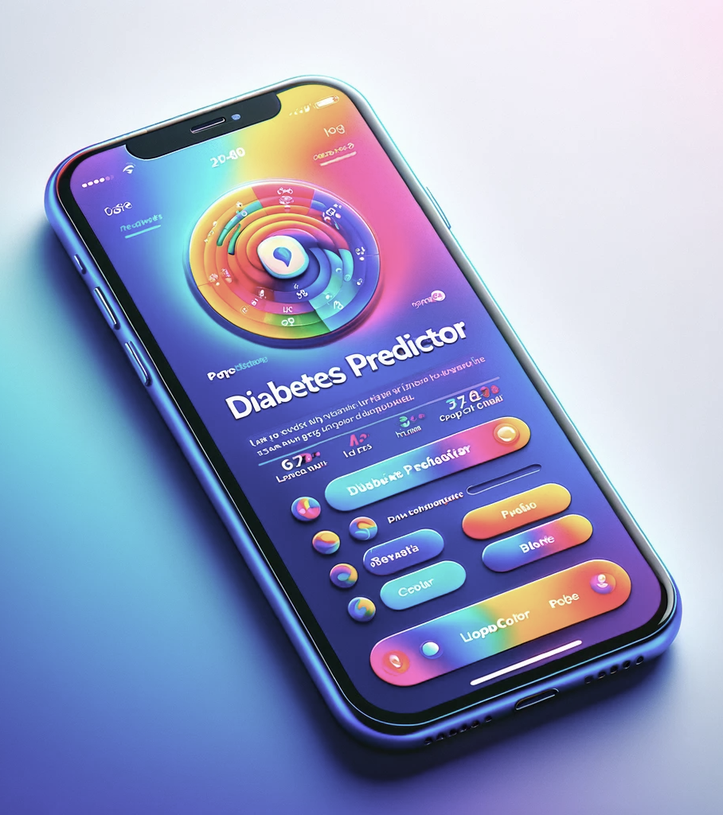
Project Goals
Model Predicts Likelihood
Requires No Doctor’s Visit
Self-reported Information
Improve Health Awareness
Early-stage Recommendation
Positive Impact Long-term
Slide 6 – M.C. Squared

Slide 7
Project Resources
Data Exploration

Slide 8




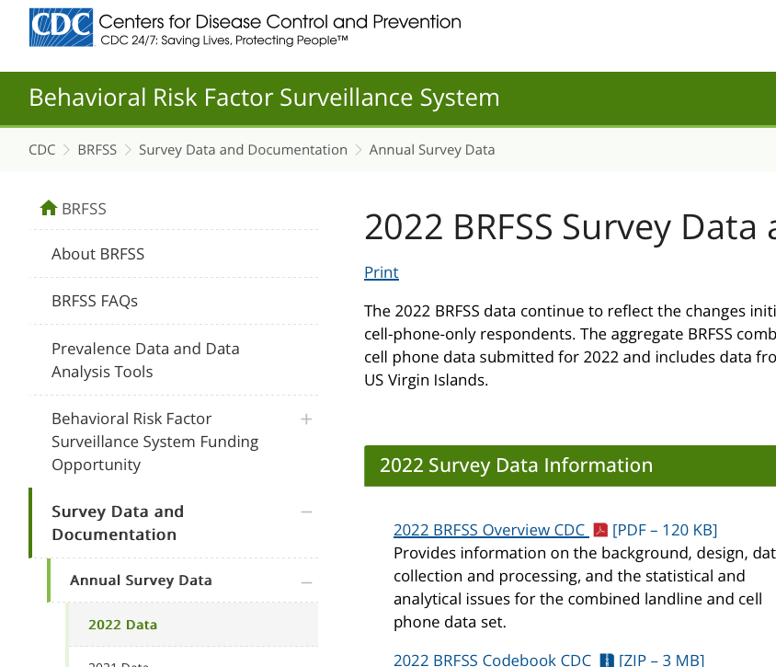
Project Resources
Slide 8 – M.C. Squared

Slide 9
Data Details
Starting Data
34 Final Feature Selections
440,000 US Respondents Representing all States
330 Self Reported Health Questions
Have You Been Told You Have Diabetes…
High Blood Pressure
High Cholesterol
BMI
Smoking
Chronic Health Conditions
Physical Activity
Diet
Etc.
Final Data
208,156 Do Not Have Diabetes
38,816 Pre or Diabetic

Slide 10
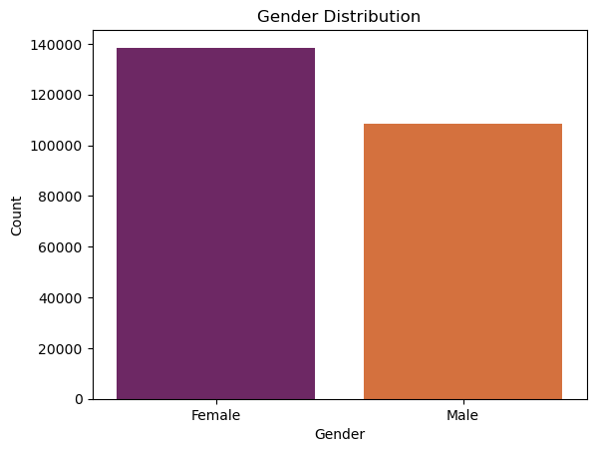
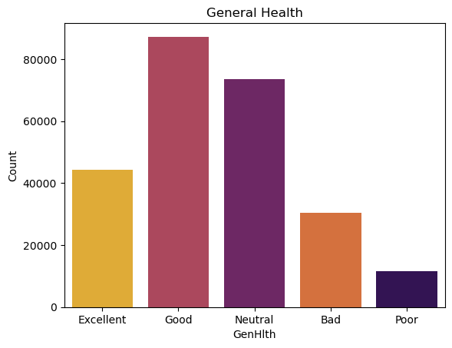
Data Exploration - Entire Dataset
Slide 10 – M.C. Squared

Slide 11
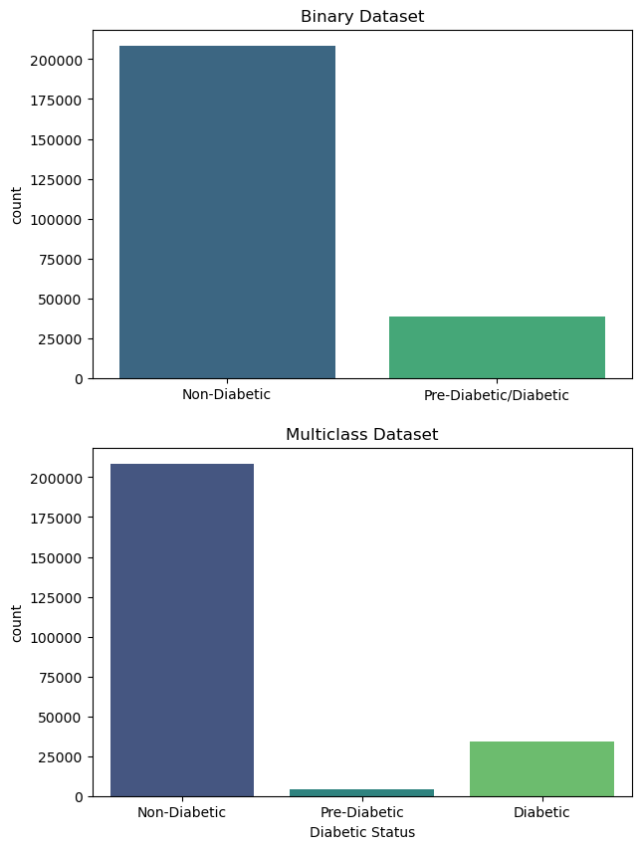
Data Exploration – Entire Dataset
Imbalanced Data!!!
Slide 11 – M.C. Squared

Slide 12
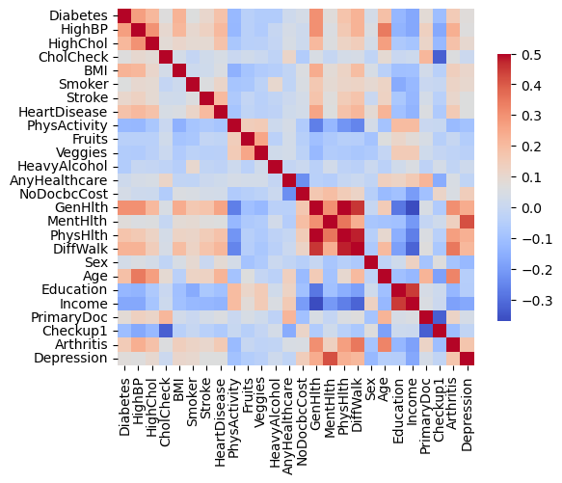
Data Visualization – Feature Correlation
Slide 12 – M.C. Squared

Slide 13
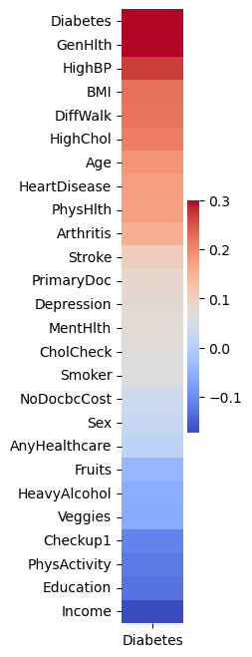
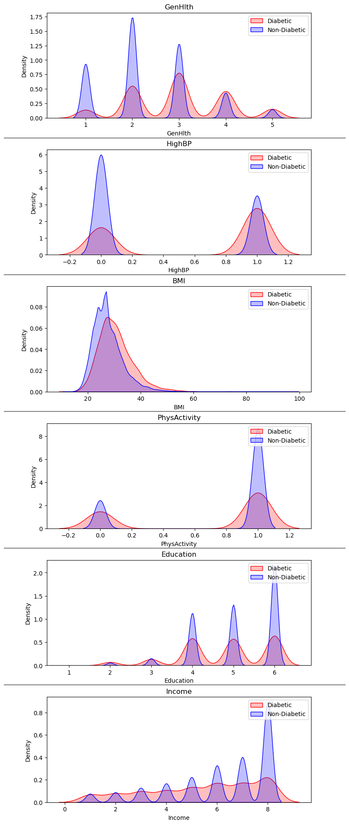
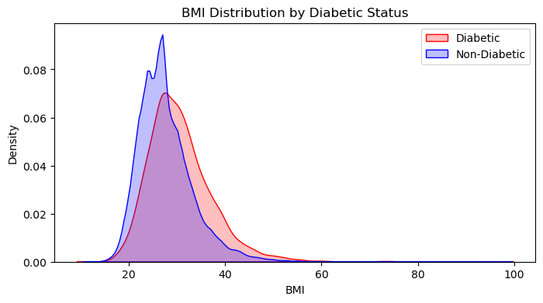
Data Visualization - Correlations
Slide 13 – M.C. Squared

Slide 14
Workflow
Model Optimization

Slide 15
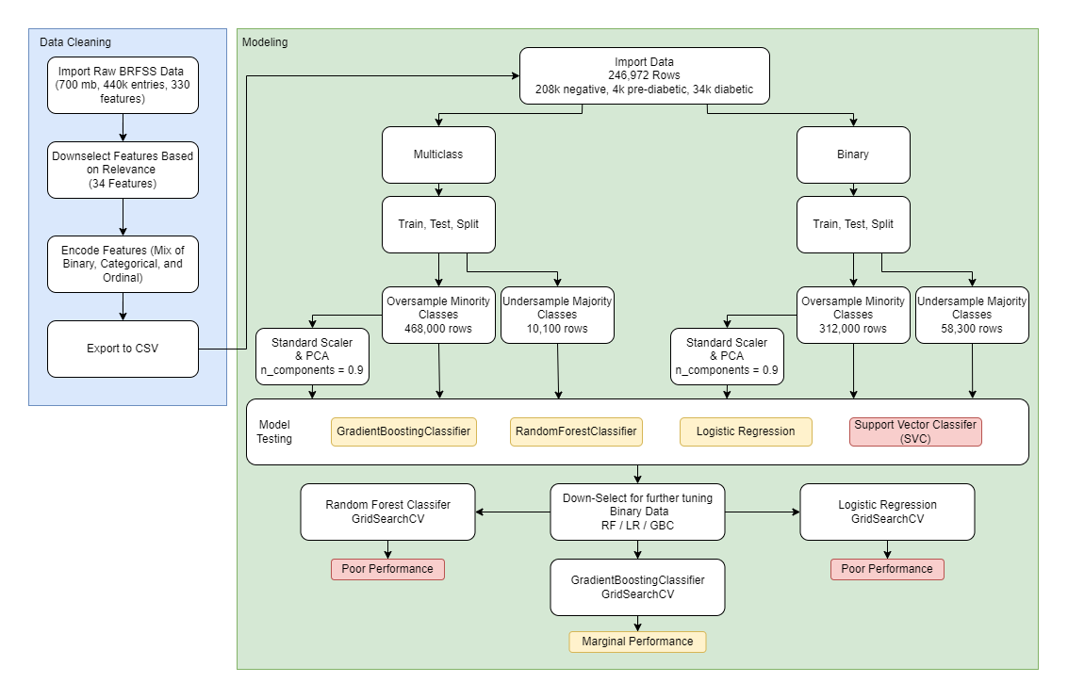
Workflow
Slide 15 – M.C. Squared

Slide 16
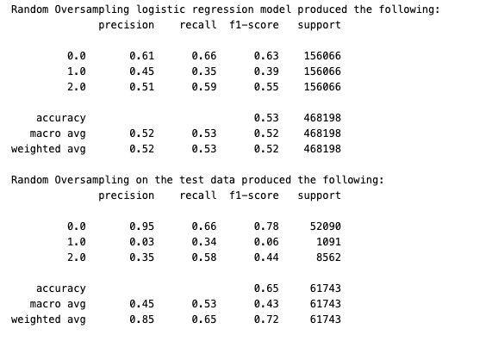
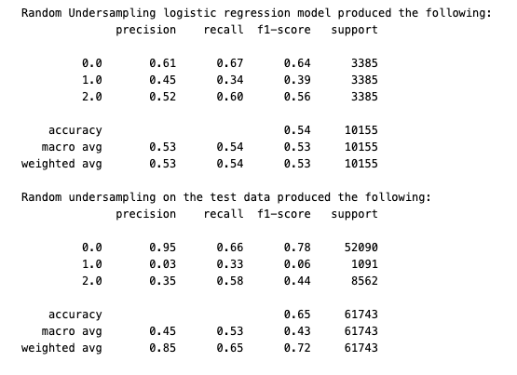
Multiclass Logistic Regression Train & Test Accuracy
Slide 16 – M.C. Squared

Slide 17
Exploring Multiclass Versus Binary
Slide 17 – M.C. Squared

Slide 18
Workflow
Slide 18 – M.C. Squared

Slide 19
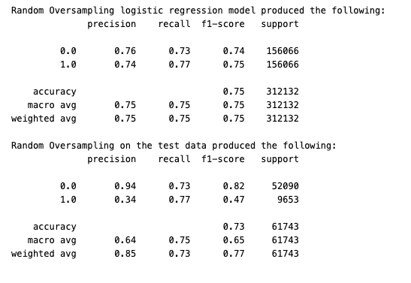
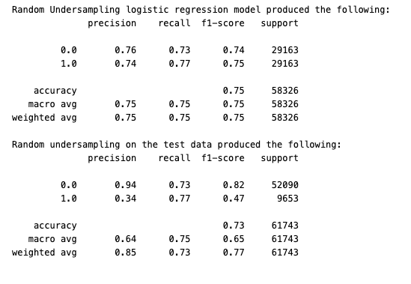
Binary Logistic Regression Train & Test Accuracy
Slide 19 – M.C. Squared

Slide 20
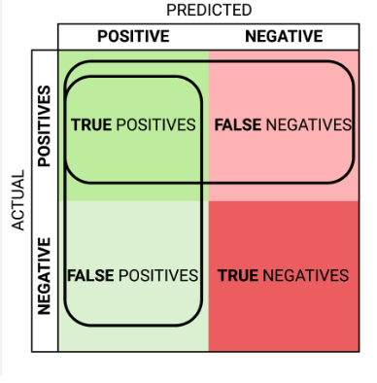
Why Recall? False Positives vs False Negatives Grid Search CV
Optimization Strategy
Slide 20 – M.C. Squared

Slide 21
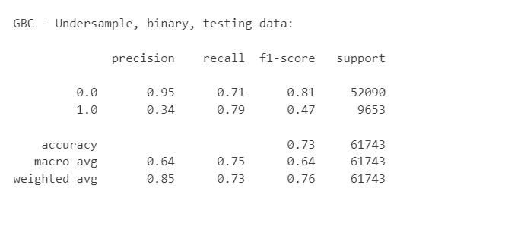
Gradient Booster Classifier Our Best Model
Slide 21 – M.C. Squared

Slide 22
Project Findings
This Data Is Not Sufficient to Predict Diabetes
Re-survey Respondents
Ask Follow Up Questions on Diabetic Symptoms
However, It Is Still Valuable
As a Pre-Screening Solution
“Potential Diabetics” Recommended to See Their Doctor
Slide 22 – M.C. Squared

Slide 23



Same Great Team…Doing More Great Things But We’ve Aged
Questions & Thank You
Matt DiPinto
Cofounder
Cindy Zhou
Cofounder
Christine Kanouff
Cofounder
(Headshot Credits: Photo Multiverse. We think this GPT may be bias towards Matt.)
Slide 23 – M.C. Squared

